Slide 1
Advanced R Training Information Session
Ron Yu, Kyle Wathen
PMs: Mukta Bahl and Lyndsey Fou 11/9/2020
Notes:
As of 2/21/2020

Slide 2
Meeting
Agenda
Purpose of this meeting
Pre-training software installations
Advanced R Training Topics
Post Training Expectations

Slide 3
Pre-training Software Installations
R, Rstudio, and Packages
1. Please download and install the latest version of R. Visit https://cloud.r-project.org/ and follow the instructions Verify that it installed correctly by typing R.Version() at the RStudio console - it should say 4.0.3 2. Verify that you have the latest version of RStudio. Open Rstudio Click "Help" -> "Check for Updates" It will either say that you have the latest version, or give you instructions on how to download and install it 3. Update all R packages. Type update.packages(ask=FALSE) at the console It might say "Do you want to install from sources the package which needs compilation? (Yes/no/cancel)". Write "no" 4. Install the latest version of the tidyverse, as well as related packages which we will be using: Type install.packages(c("babynames", "formatR", "gapminder", "hexbin", "mgcv", "maps", "mapproj","nycflights13", "tidyverse", "viridis"))

Slide 4
Advanced R Training Topics
Day 1 – Advanced R Training
Introduction, ggplot2, dplyr, and Data Import
Day 2 – Advanced R Training
Exercises applying ggplot2 and dplyr to dummy clinical trial data, R markdown; and if time permits, string manipulation (with the stringr package), and date and time manipulation (with the lubridate package)

Slide 5
Post Training Plans – 2021
Sample Sign up sheet
Topics | Main Instructor(s) | Backup Instructor(s)
Introduction
ggplot2
dplyr
Data import
R markdown
Exercises applying ggplot2 and dplyr to dummy clinical trial data
Other topics
Sample list of topics

Slide 6
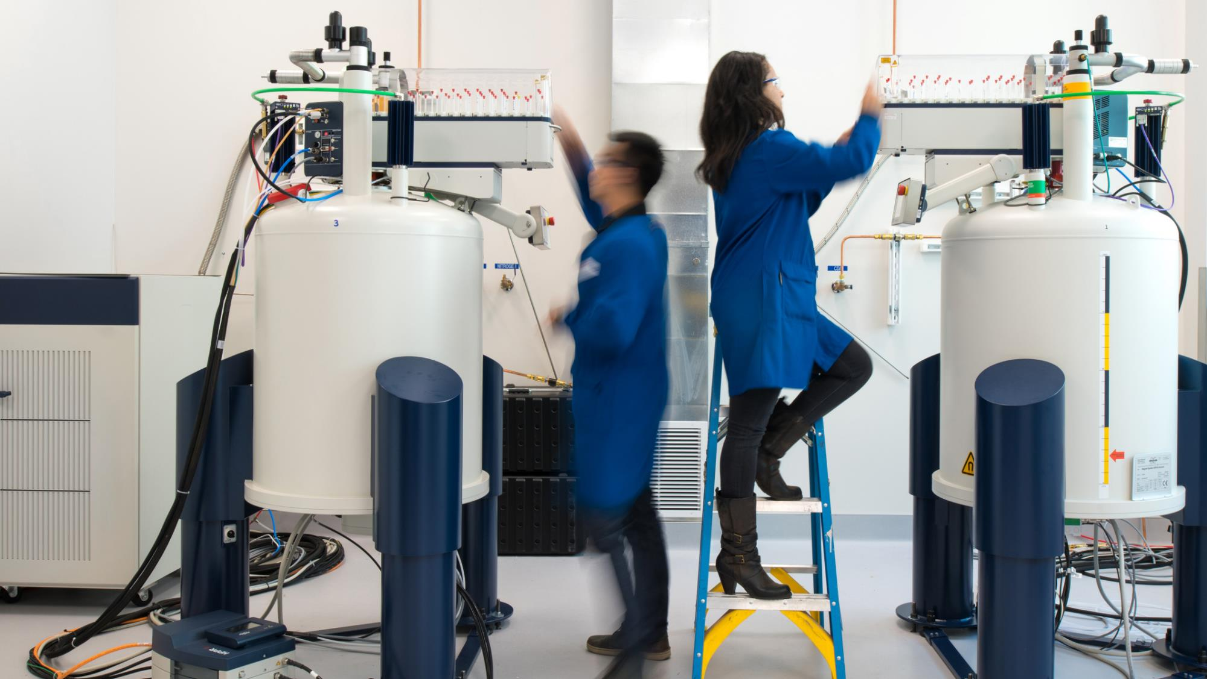
THANK YOU

